Slide 1
Stock Market News Sentiment Analysis and Summarization
Natural Language Processing
14th April 2025

Slide 2
Contents / Agenda
Executive Summary
Business Problem Overview and Solution Approach
EDA Results
Data Preprocessing
Model Performance Summary
Appendix

Slide 3
Executive Summary
Data set is carefully validated for univariant and bi variant Analysis . Data is processes for validating under training and Test ,along with validation.
With the data, model is generated on Word2vec, Glove and sentence transformer .
Both base and Tuned are generated for the analysis.
Sentimental analysis is performed on the six-model generated. This will help to generate the summarization on the words based on the requirement .
Then the final output is generated to sort the data set based on the positive and negative feedbacks

Slide 4
Business Problem Overview and Solution Approach
Stock price varies in every sec in this modern world. As a result , invertment firms need sophisticated tools to analyze market sentiment and integrate this information into their investment stratergies
The solution approach is an AI driven sentiment analysis system that will automatically
Process and analyze news articles to guage market sentiment and summerizing the news at a news at a weekly level to enchancethe accuracy of their stock price predictions and optimize investment stratergies.

Slide 5
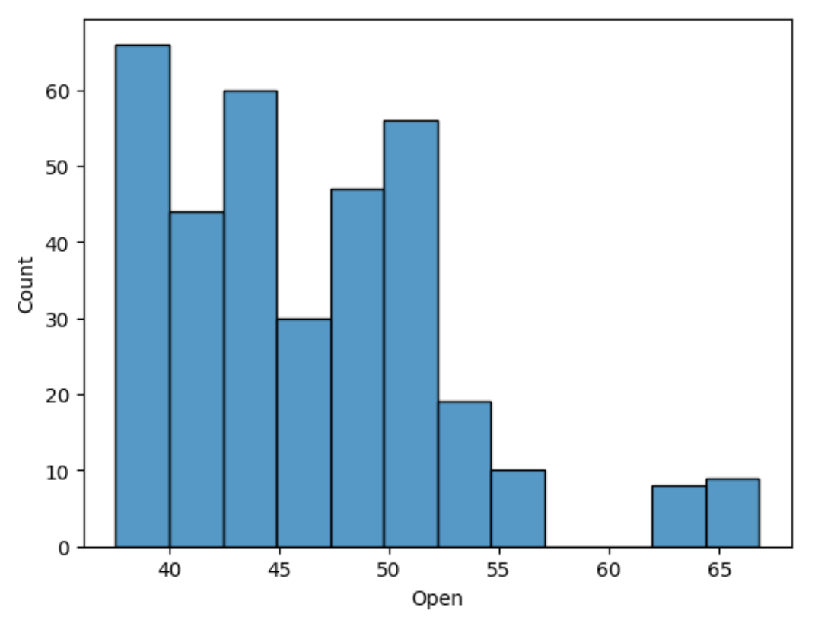
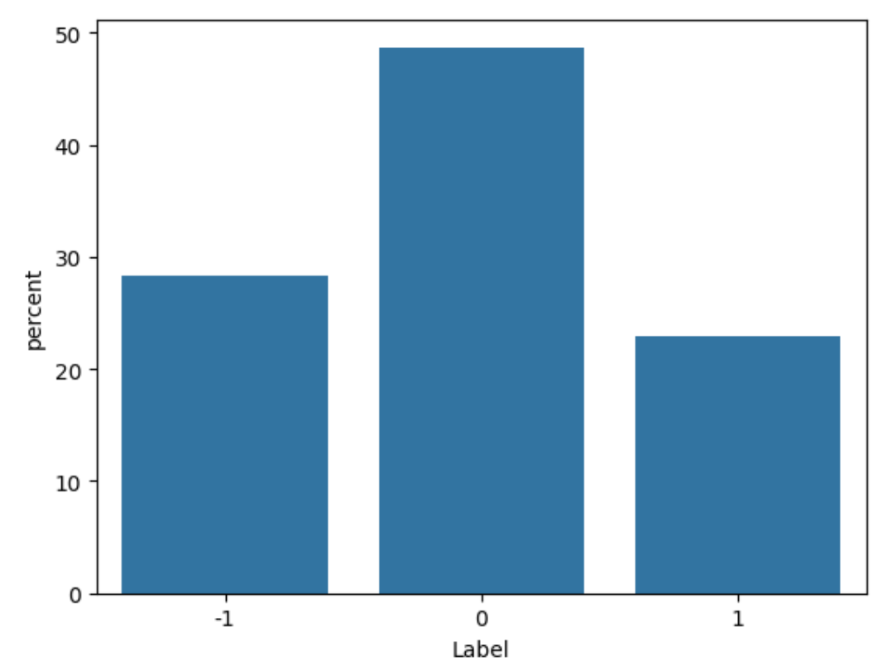
EDA Results
In the Univariate analysis

Slide 6
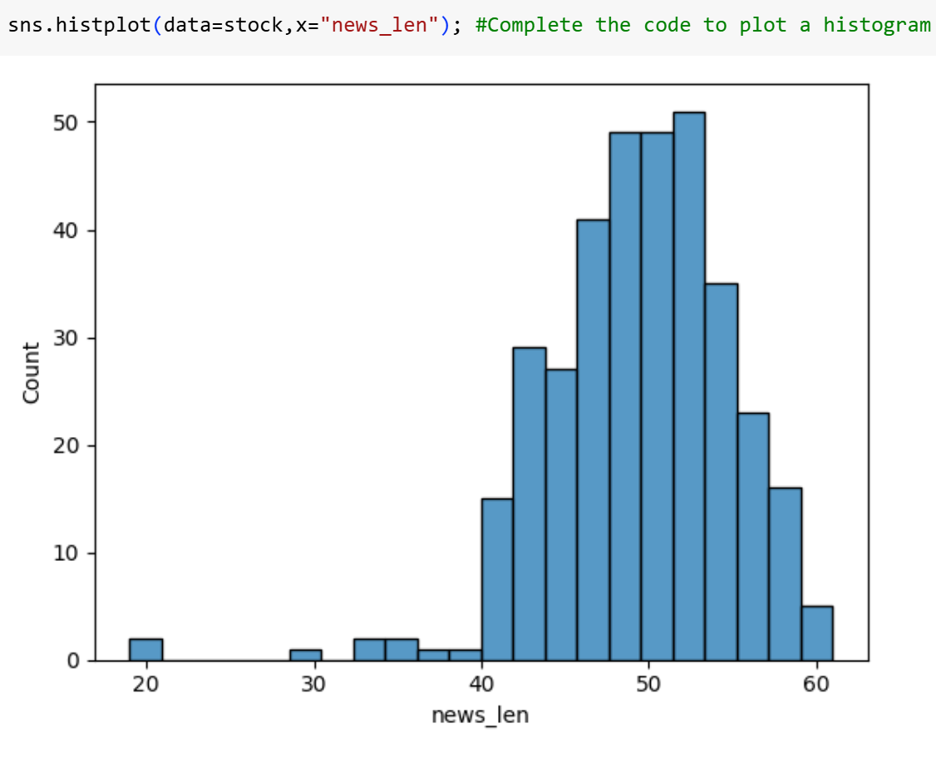
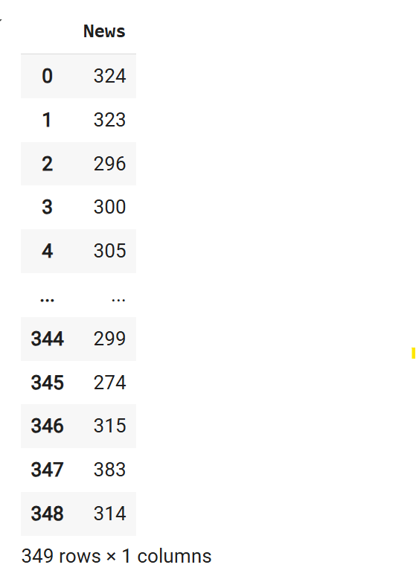
EDA Results
In the Univariate analysis
The univariate chart is generated to understand
the behavior of one variable with respect to dependent variable.
From this , it is clear that the data distribution is not uniform across.
Mean is along the 50

Slide 7
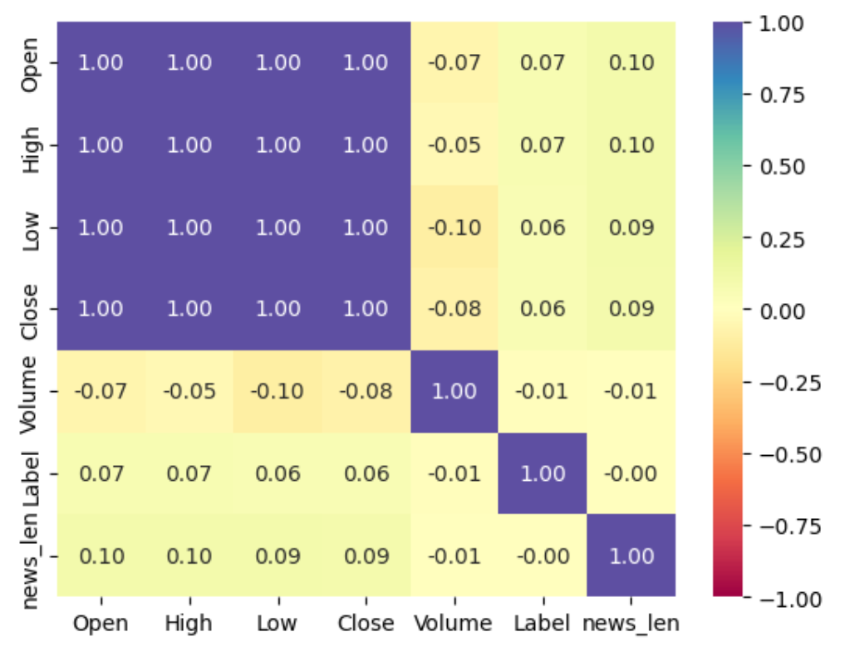
EDA Results
In the Bi variate analysis
A heat chart (more commonly called a heatmap) is a type of data visualization that shows the magnitude of values across a matrix as colors. It's perfect for visualizing things like correlation matrices, confusion matrices, or feature relationships.

Slide 8
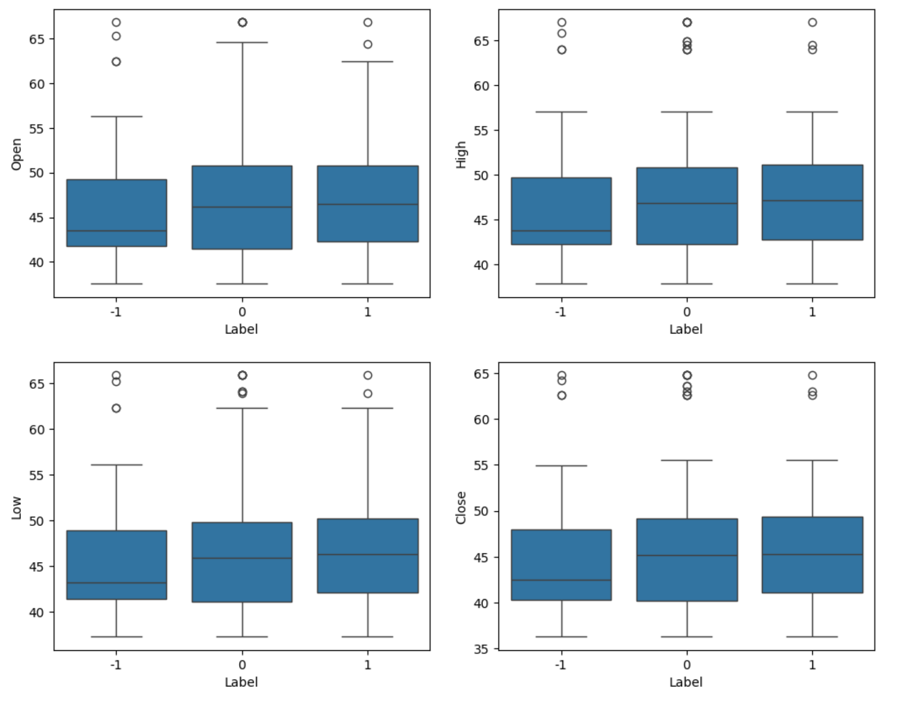
EDA Results
There were many outliers on all the open
, High,Low,Close.
Each shows how a stock feature (Open, High, Low, Close) varies across different Label categories. Makes it easy to spot differences in distribution or outliers based on labels (e.g., price going up/down)

Slide 9
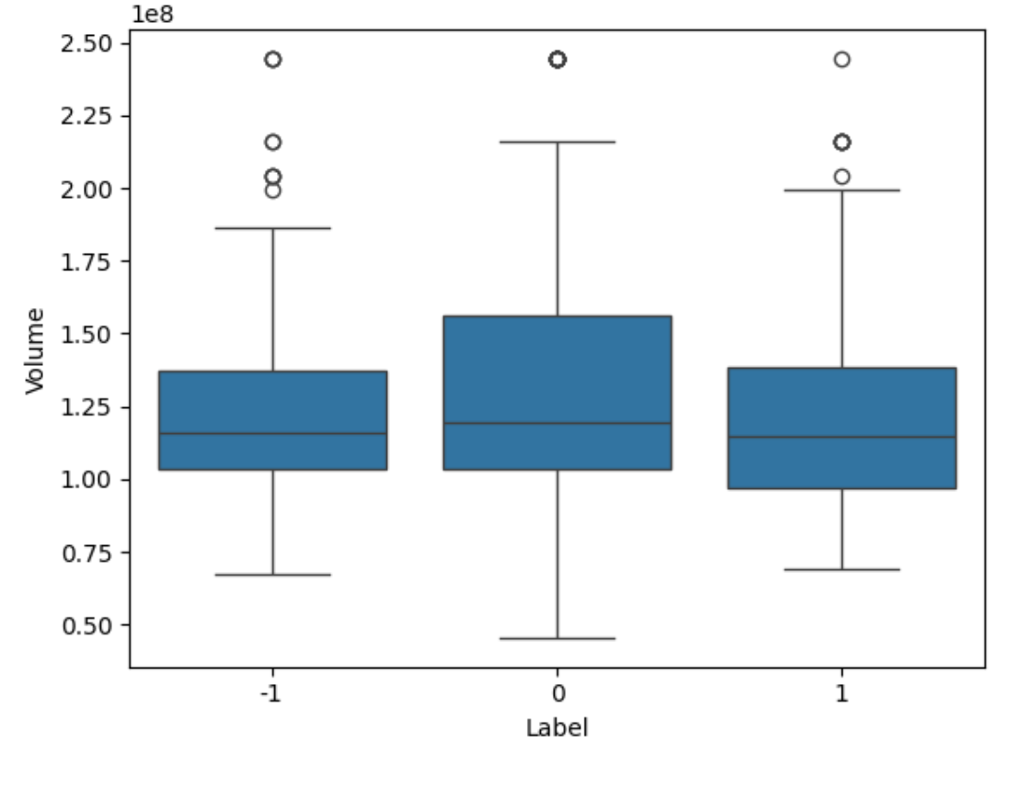
EDA Results
Compares stock trading volume across different labels .
Useful to see if certain labels are associated with higher or more variable volume.

Slide 10
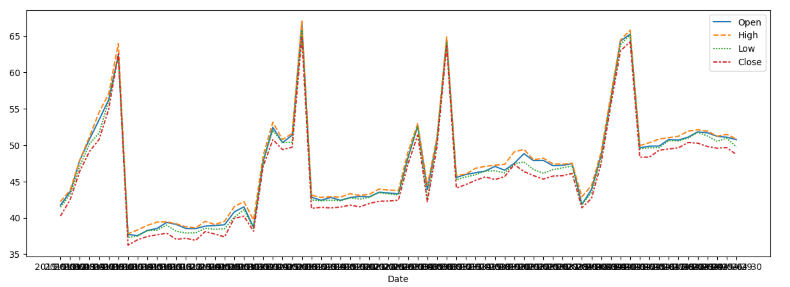
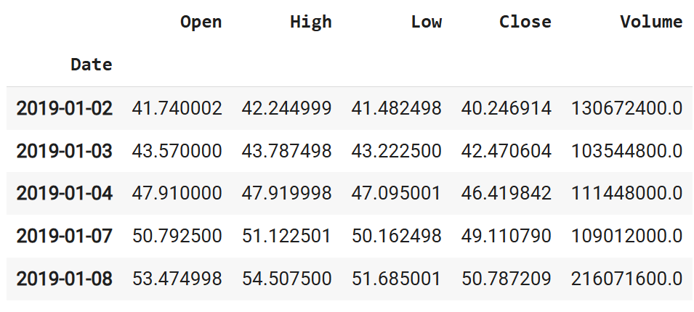
EDA Results

Slide 11
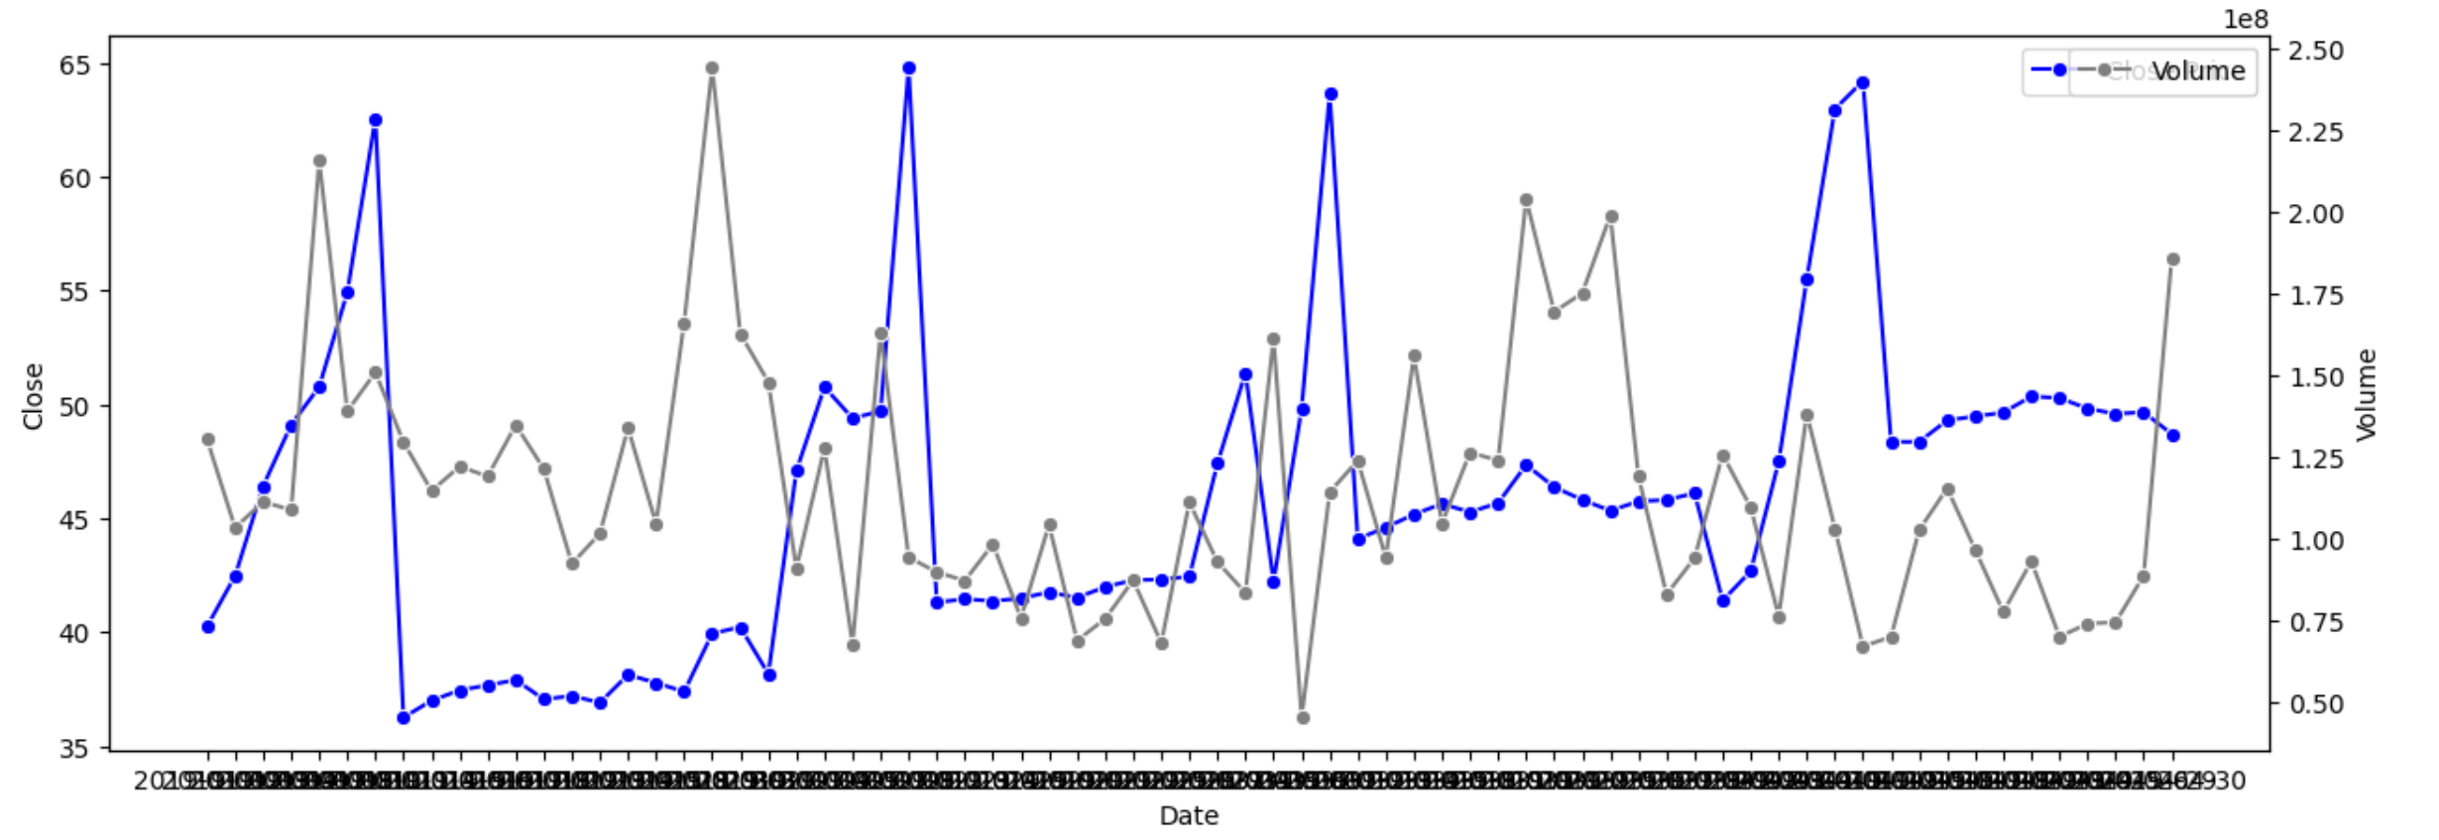
EDA Results
Volume Spikes ≠ Price Spikes: High volume doesn’t always mean big price movement — sometimes price remains flat.
Sharp price movements often occur with volume surges, suggesting market reactions to external factors.
There's a consistent range in volume, but price shows higher variability.

Slide 12
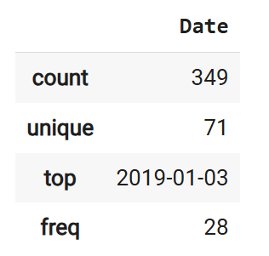
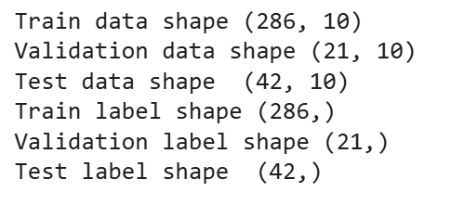
EDA Results

Slide 13
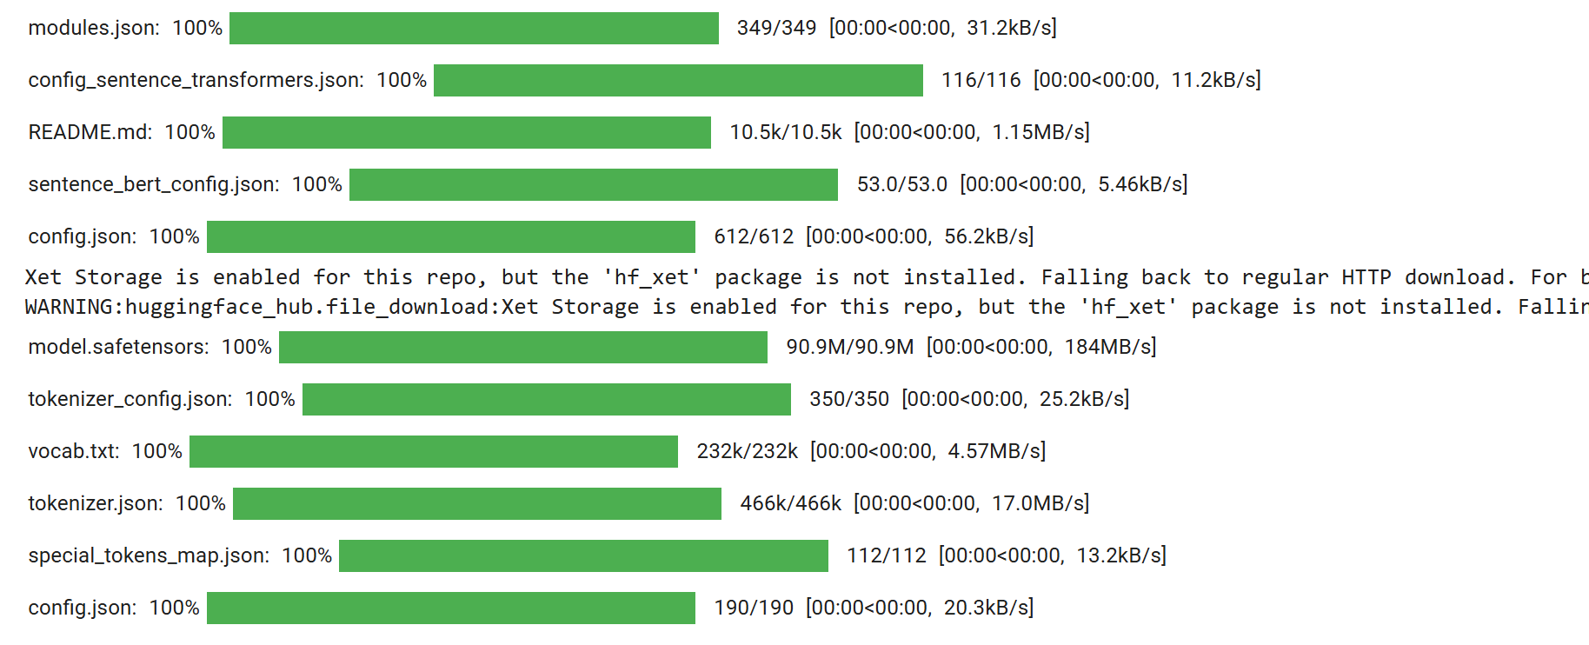
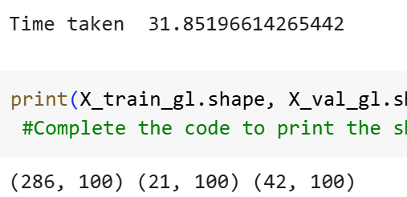
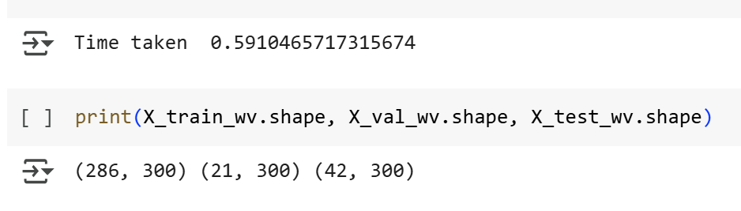
EDA Results

Slide 14
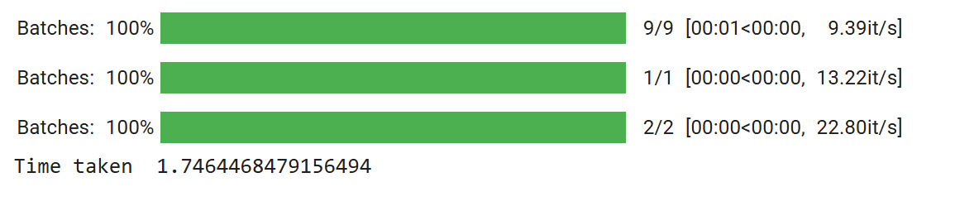

Data Preprocessing

Slide 15
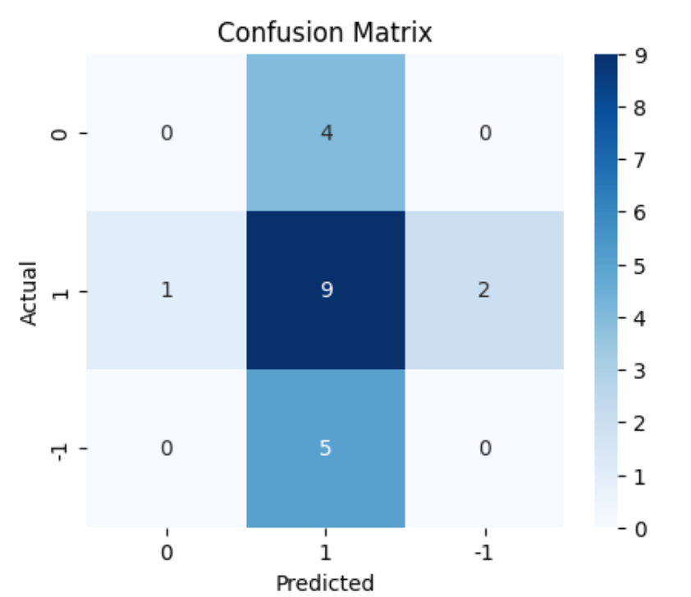
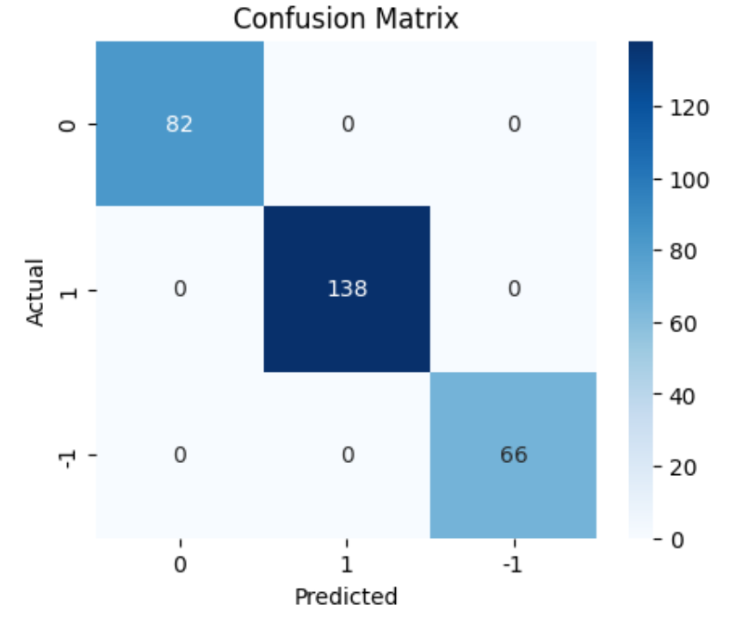
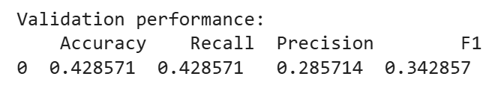
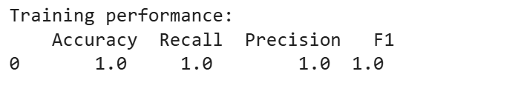
Sentiment Analysis - Model Evaluation Criterion
Base Model - Word2Vec
Word2Vec is a popular technique in natural language processing (NLP)
for transforming words into vector representations—essentially,
turning words into numbers that a machine can understand, while capturing
their meaning and relationships.

Slide 16
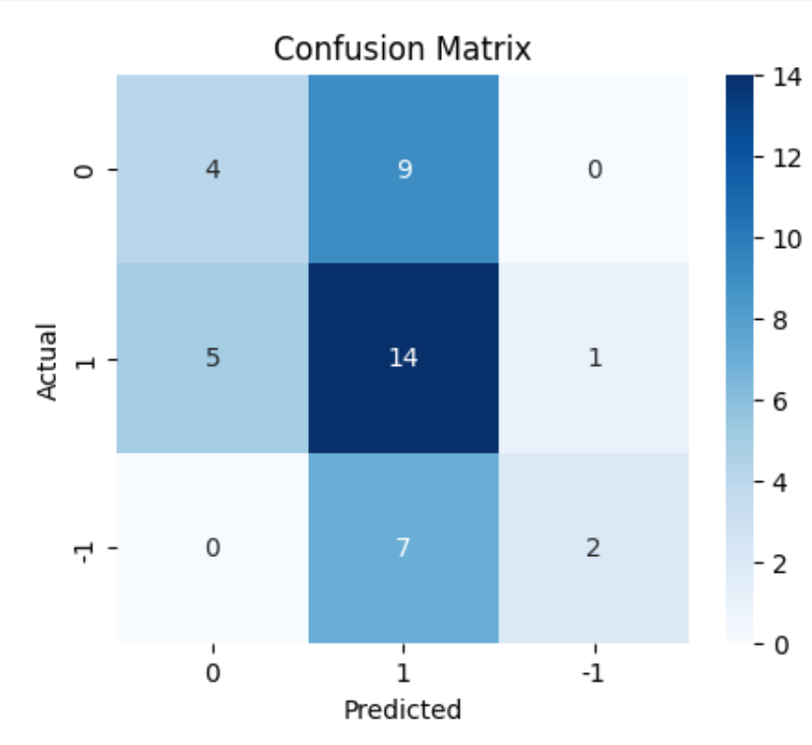
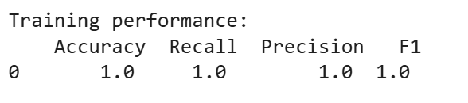
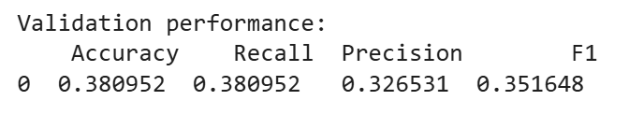
Sentiment Analysis - Model Evaluation Criterion
Base Model - GloVe
GloVe is an unsupervised learning algorithm developed by
researchers at Stanford for generating word embeddings.
It combines the global statistical information of a corpus
(like how often words co-occur) with the local context of words to
produce word vectors.

Slide 17
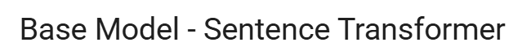
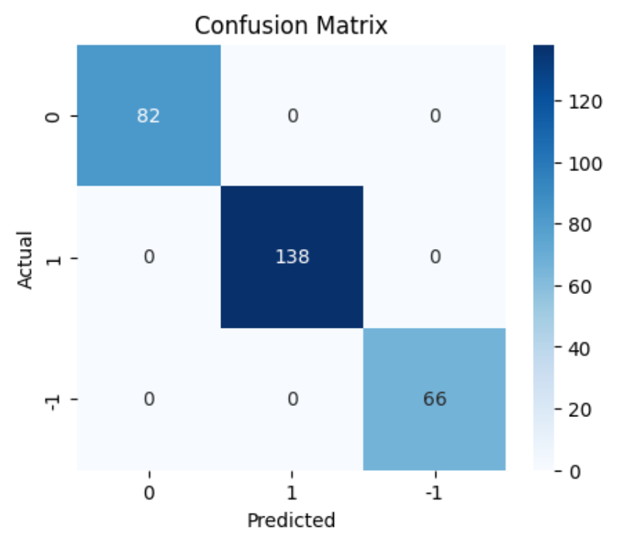
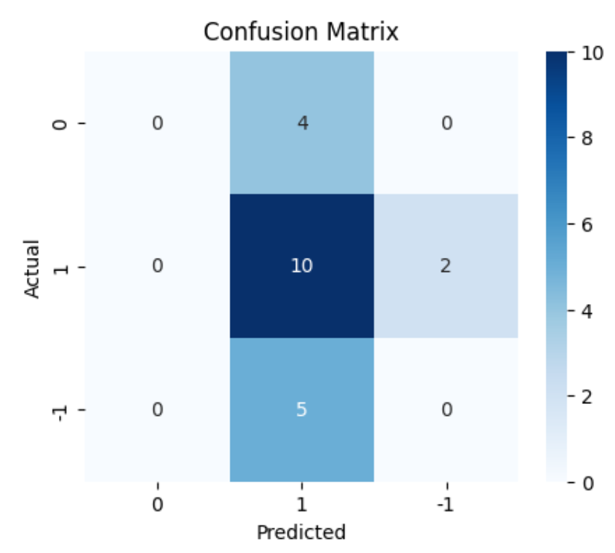
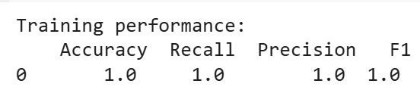
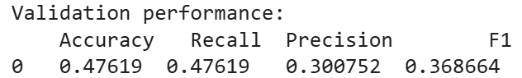
Sentiment Analysis - Model Evaluation Criterion
A Sentence Transformer is a type of model that converts entire sentences (not just individual words) into dense vector embeddings that capture their semantic meaning. These embeddings are designed so that similar sentences are close together in vector space, even if they use different words. It builds on the Transformer architecture, especially BERT and its variants.

Slide 18
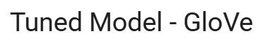
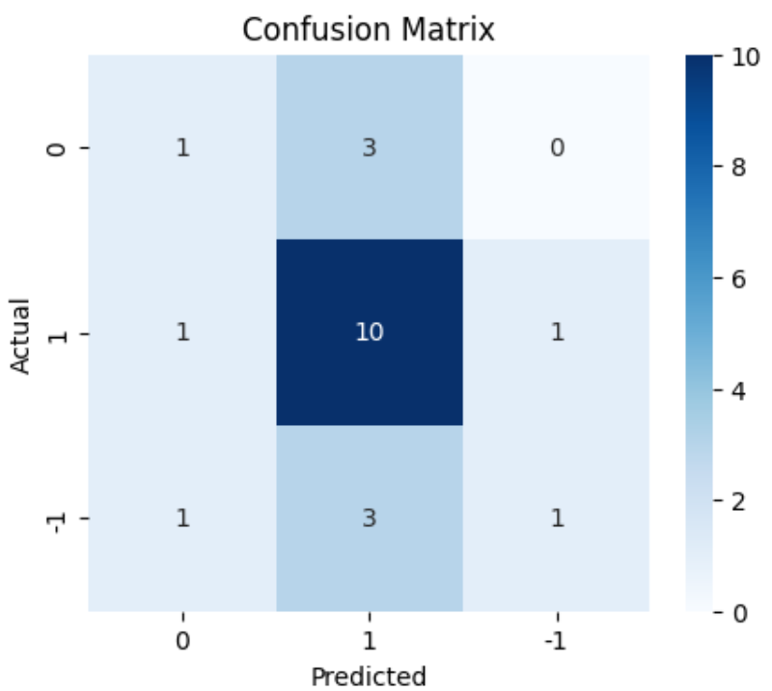
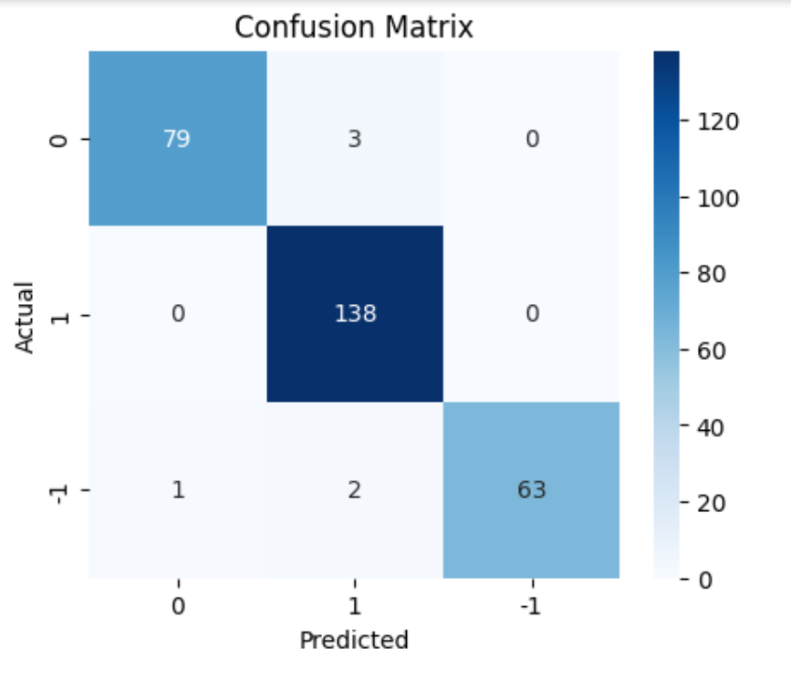
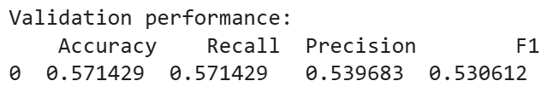
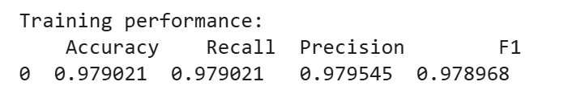
Sentiment Analysis - Model Evaluation Criterion
Base glove model is finely tuned for the better. Pre-trained models are more powerful .Tuning the chart makes More accurate.

Slide 19

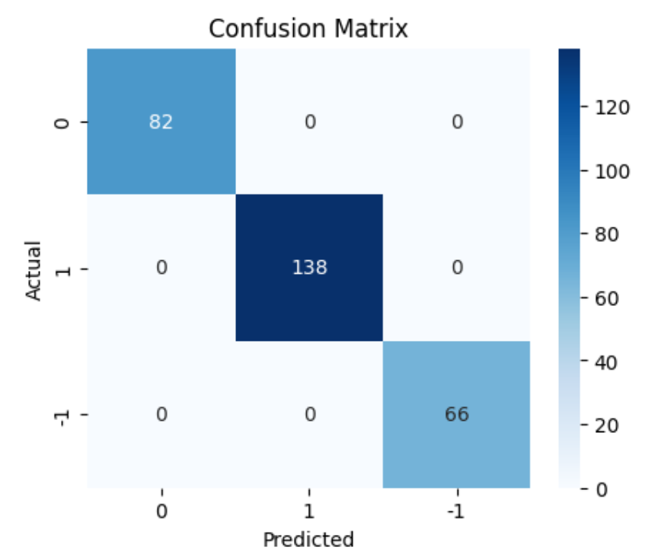
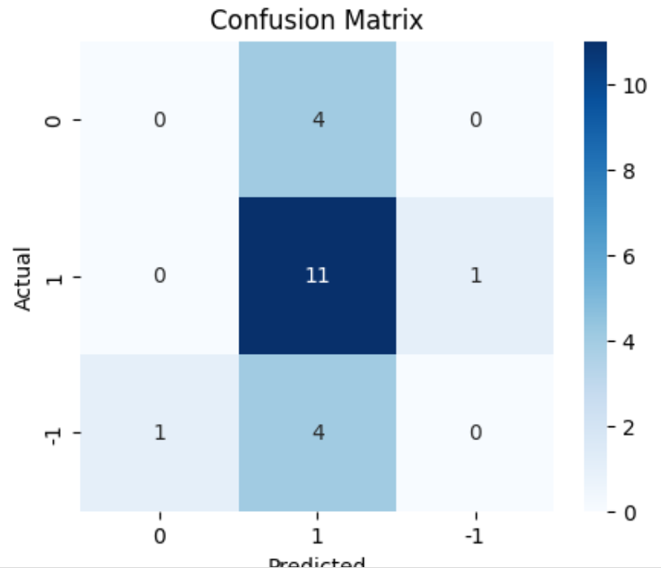
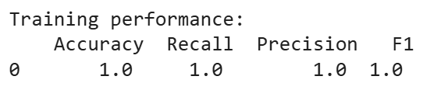
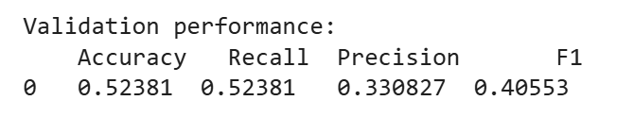
Sentiment Analysis - Model Evaluation Criterion
Word2Vec is static , so even a tuned model cant understand contextual word meanings, tuning requires ample data to be effective.word2Vec works well in resource-limited environments.

Slide 20
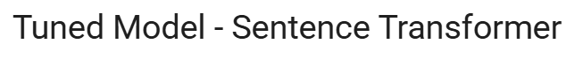
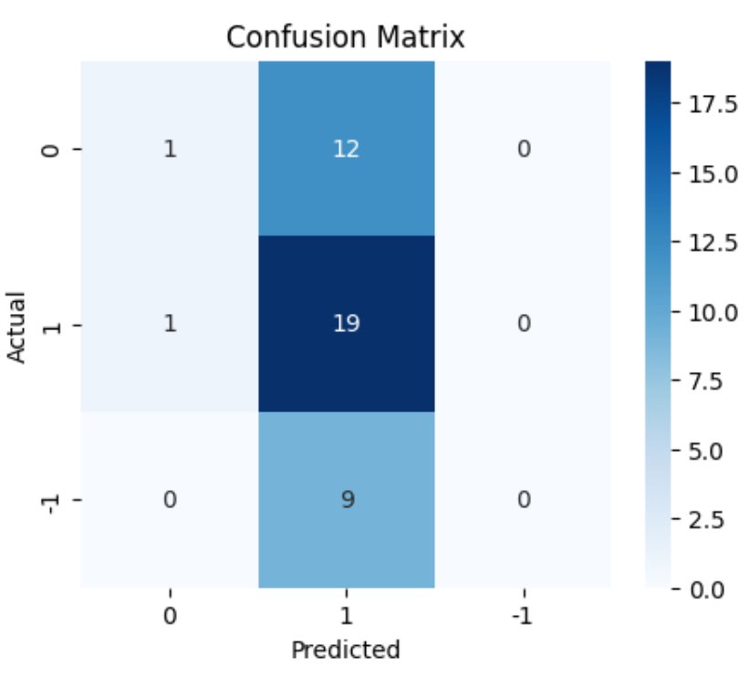
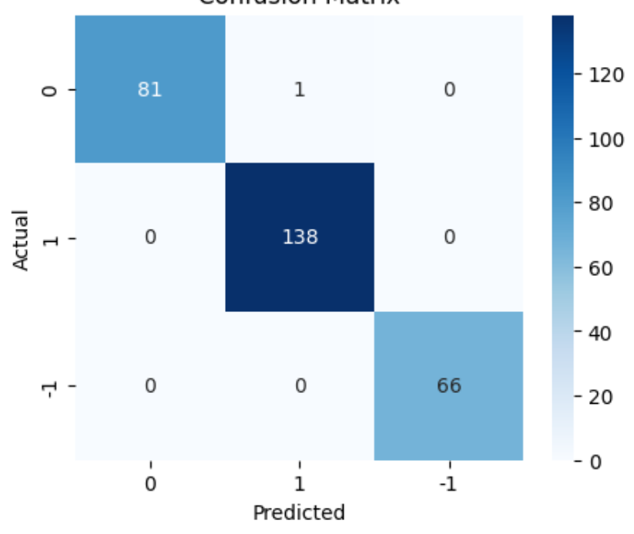
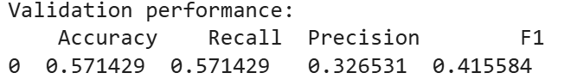
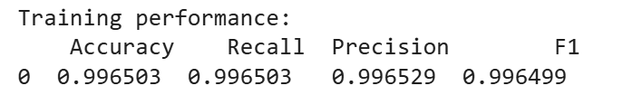
Sentiment Analysis - Model Evaluation Criterion
Embeddings are more task-aware
A tuned Sentence Transformer is a pre-trained model
that has been fine tuned on a specific task or domain.
For semantic search , tuned embedding gets better.,Compact models with better accuracy

Slide 21
Sentiment Analysis - Model Building

Slide 22
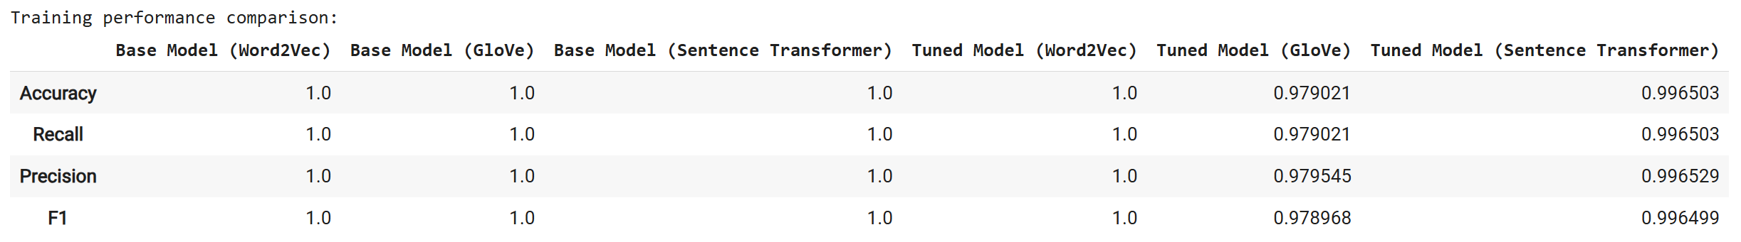
Sentiment Analysis - Model Improvement
comparing the training performance of six different models, which vary by:
The type of word embeddings used (Word2Vec, GloVe, Sentence Transformer),
Whether the model is base or tuned.
Base_train_wv, base_train_gl, base_train_st, etc. are likely DataFrames or Series that store training metrics like accuracy, precision, recall, F1-score, etc.
.T means transpose, switching rows and columns.
Why? Because each model's metrics are probably in a column, and to line them up side by side, we need to transpose so the metrics become rows.
pd.concat([...], axis=1):
Combines all these transposed models column-wise into one big DataFrame.
This way, you end up with a single DataFrame where:
Rows = metrics (e.g., accuracy, precision, etc.)
Columns = different models
This code lets you compare model performance side by side, making it easy to see:
Which embeddings perform better,
Whether tuning helps,
Which model is overall best for your training set.

Slide 23
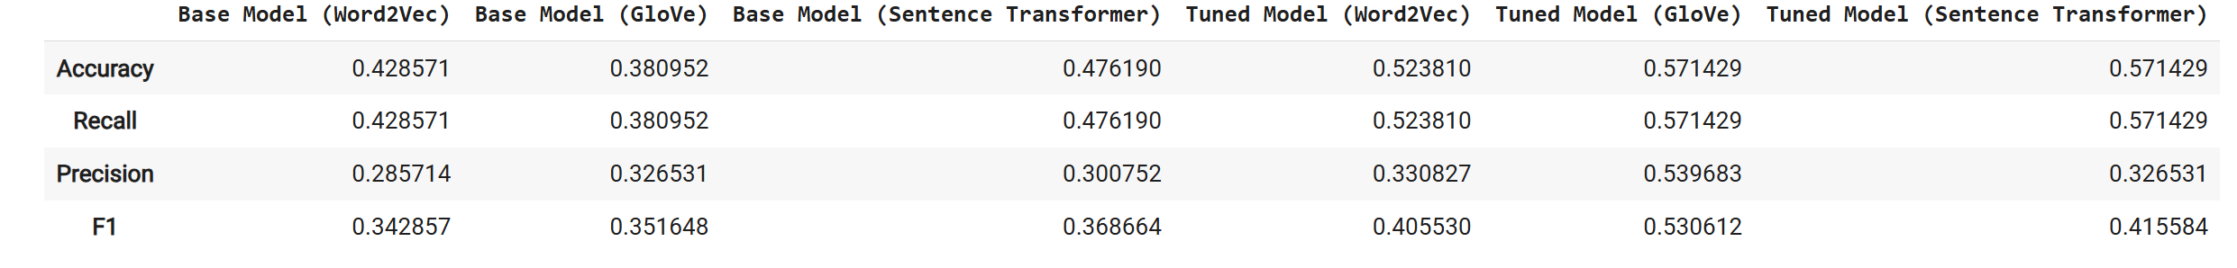
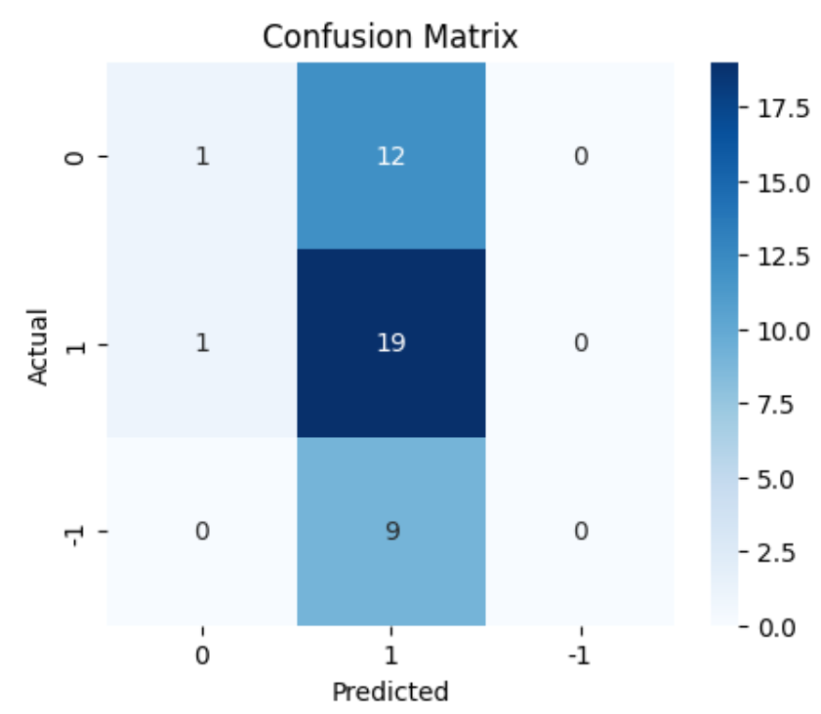
Sentiment Analysis – Final Model

Slide 24

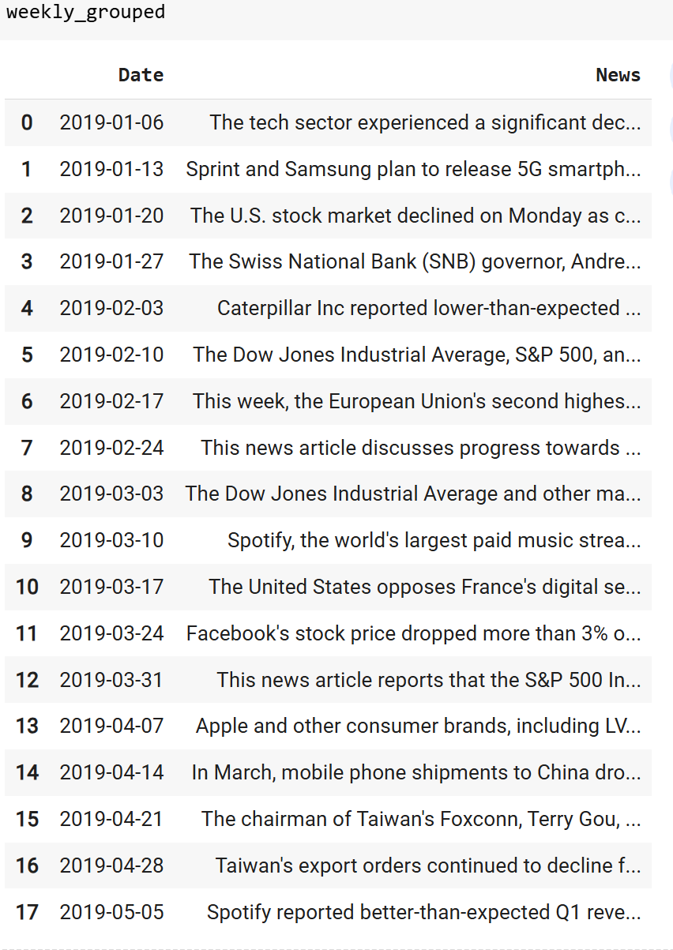
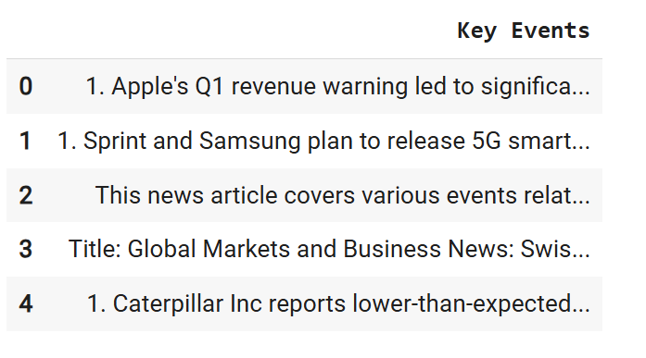
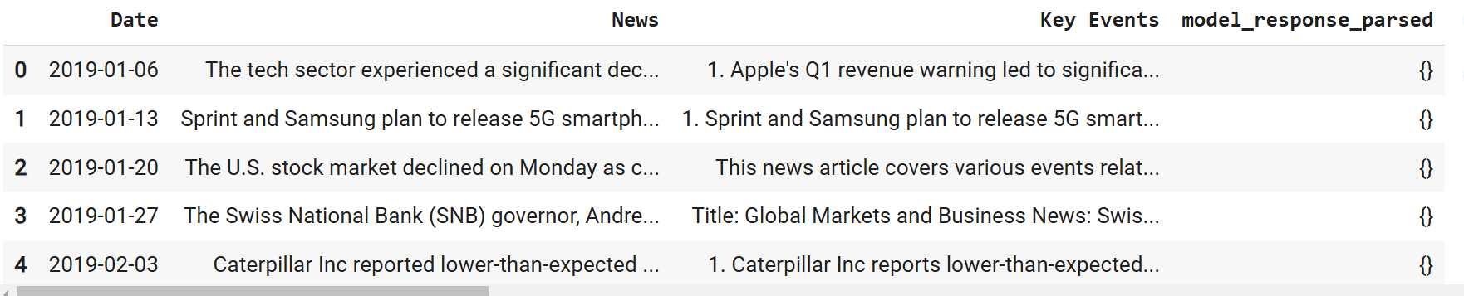

Slide 25
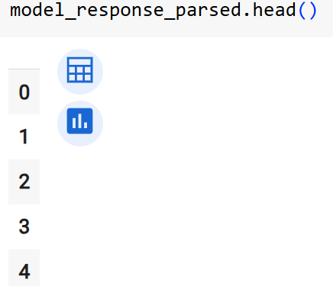
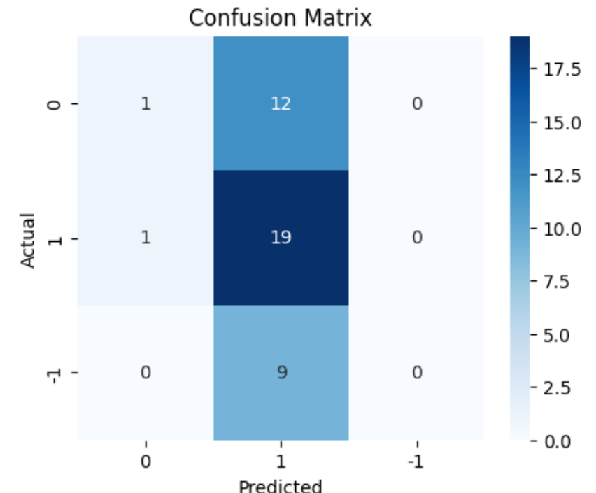



Content Summarization – Modeling Approach
Inference: Transformer model is best. With the transformer, the task is achieved.

Slide 26
APPENDIX

Slide 27



Data Background and Contents

